Slide 1
.Net Programming
Ngo Lam Trung
School of Information and Communication Technology
Office: 505-B1
E-mail: trungnl@soict.hust.edu.vn

Slide 2
Topic 5: Threading and Asynchronous
Asynchronous invocation
System.Threading
async/await

Slide 3
Why threading/asynchronous?
Blocking function call: function will block until response/result is available.
Performance affect:
Low responsive UI
Low throughput server application
➔ Asynchronous programming

Slide 4
Asynchronous programming
Non-blocking function call: function exits even before result is available
Function body is executed on a different thread
When the expected result is available, there will be a “signal”

Slide 5
1. Asynchronous Invocation
Implement through delegate
Delegate: type-safe, object oriented function pointer
Eg:
public delegate int BinaryOp(int x, int y);
→ Pointer to functions that:
- accept 2 integer arguments (by value)
- return an integer

Slide 6
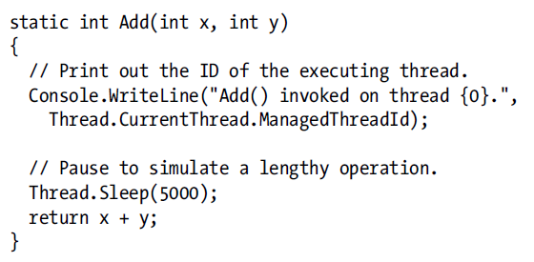
Sample 1: synchronous invocation

Slide 7
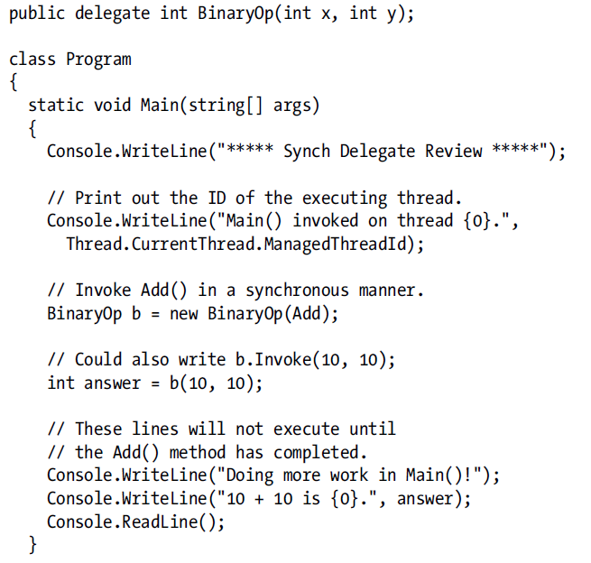
Notes:
What should be shown on output screen?
Is there any delay?

Slide 8
Comments from sample 1
The invocation of BinaryOp is synchronous → there is delay before the main function can proceed
The delay is equal to frozen UI in graphics app
In the ideal case, BinaryOp should be run on a separate thread so the main function can execute other tasks

Slide 9
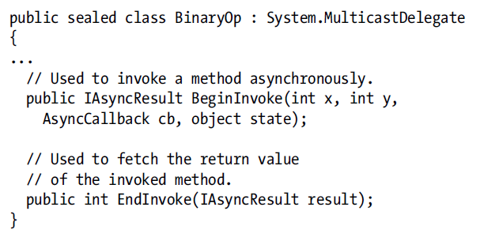
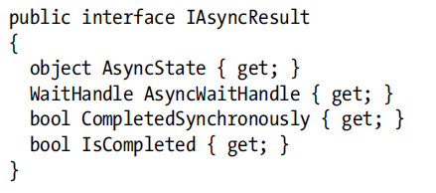
Sample 2: non-blocking invocation
The BinaryOp after compilation
➔ Non-blocking invocation of BinaryOp can be done via BeginInvoke
/EndInvoke

Slide 10
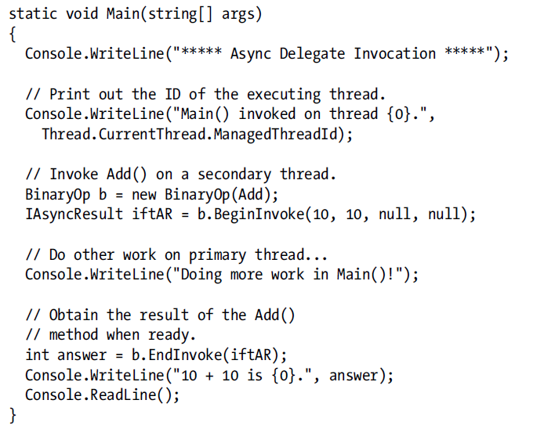
Sample 2:
Notes:
What is output?
What is different from output of sample 1?

Slide 11
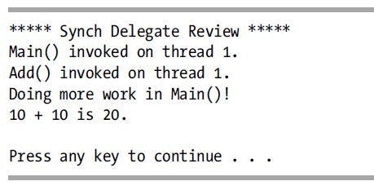
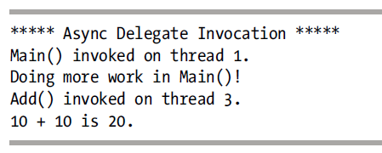
Result
Sample 2: main and BinaryOp run on different threads
“Doing more work” is done right after BeginInvoke

Slide 12
Comments from sample 2
Is there any synchronous call?
Why?
➔ there should be way to “signal” the completion of delegate

Slide 13
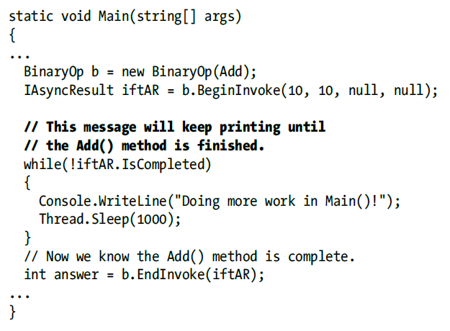
Sample 3: IAsyncResult’s IsCompleted

Slide 14
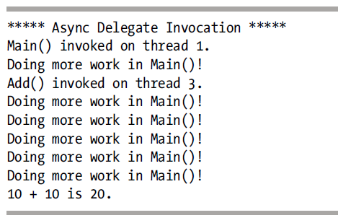
Sample 3’s comment
Better use of CPU time
Not really “asynchronous” → still have to continuously checking status of delegate

Slide 15
Sample 4: asynchronous invocation
From the def of BeginInvoke
AsyncCallback cb can be used as the asynchronous callback function

Slide 16
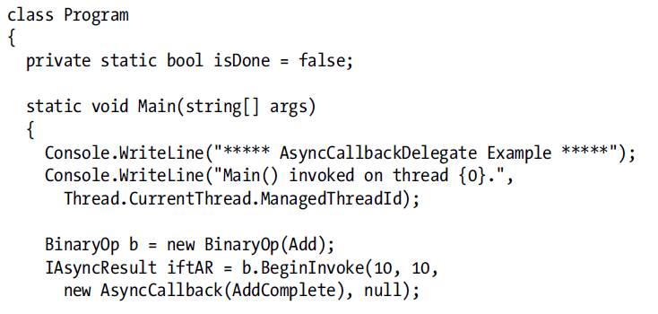
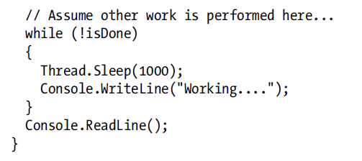

Slide 17
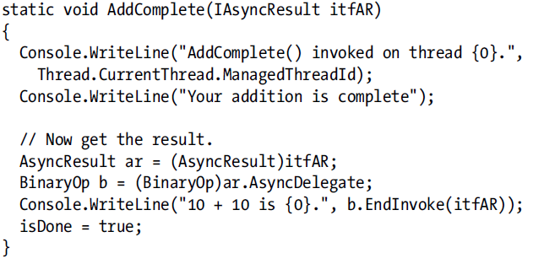
The callback function
Notes:
What is the result?
What is the difference in code structure?

Slide 18
Passing custom data
The callback function may receive some custom data from the caller
Useful when one callback function is called multiple time because of there are multiple caller → need to match callback instance with appropriate caller
Using the 4th argument of cb

Slide 19
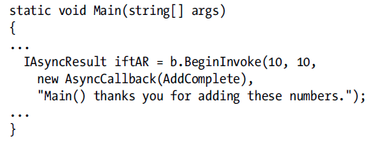
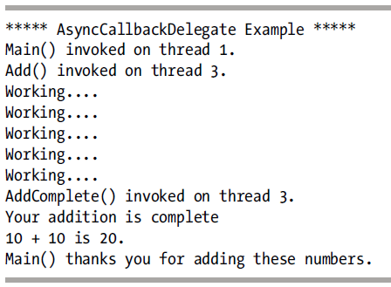
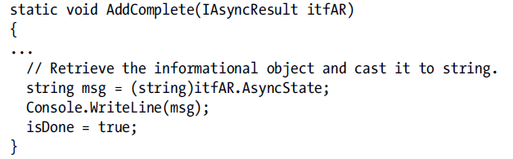
Passing custom data

Slide 20
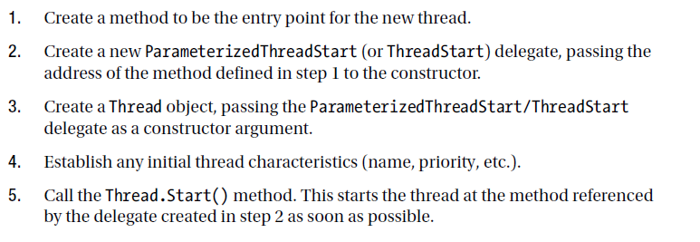
2. Explicitly creating threads

Slide 21
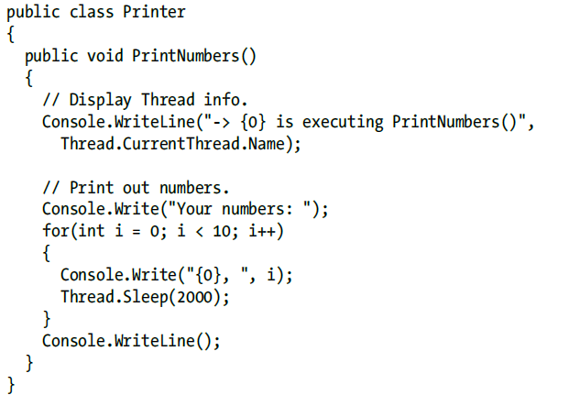
Sample: creating thread

Slide 22
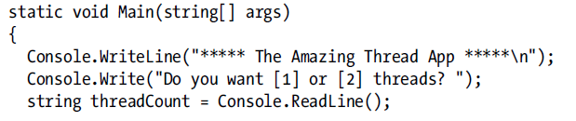
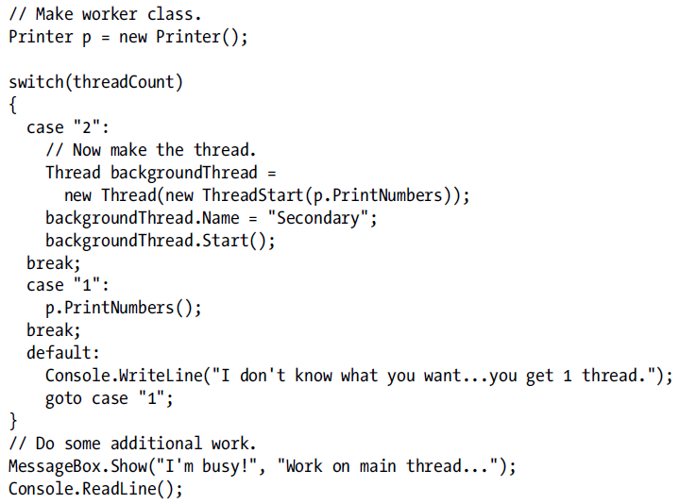

Slide 23
Creating parameterized thread
Predefined a function
func(object)
ThreadStart(func) → ParameterizedThreadStart(func)
Thread.Start(void) → Thread.Start(object)

Slide 24
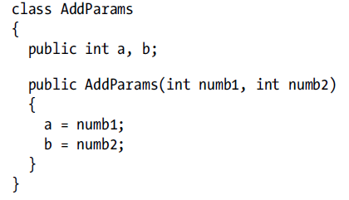
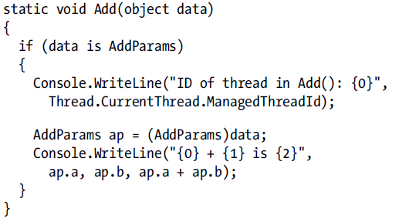

Slide 25
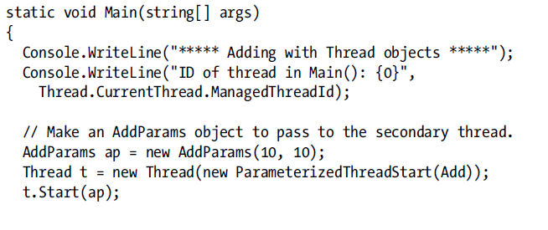
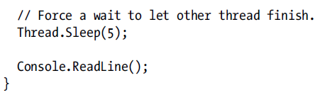
Notes:
Why do we need the line Sleep(5)?

Slide 26
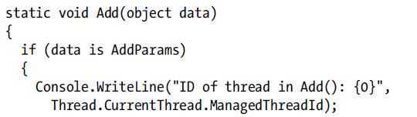
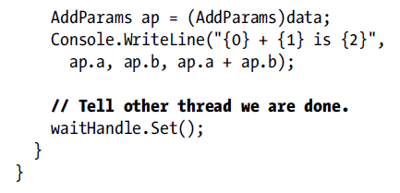
Thread synchronization
When a thread needs to wait for another thread → using AutoResetEvent

Slide 27
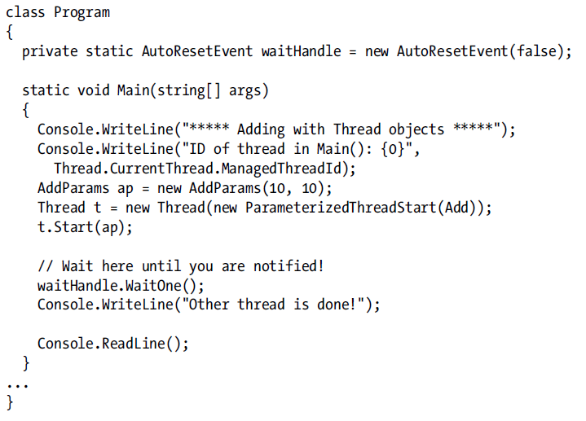

Slide 28
Critical sessions
When shared data needs protection to avoid simultaneously access from different threads
When some code block should be executed at once

Slide 29
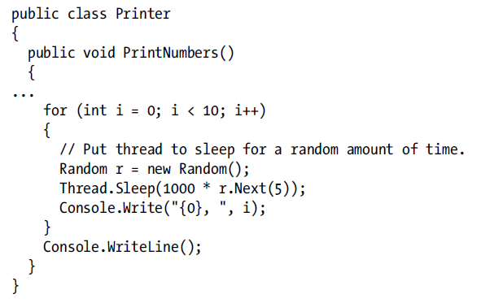
Concurrency problem

Slide 30
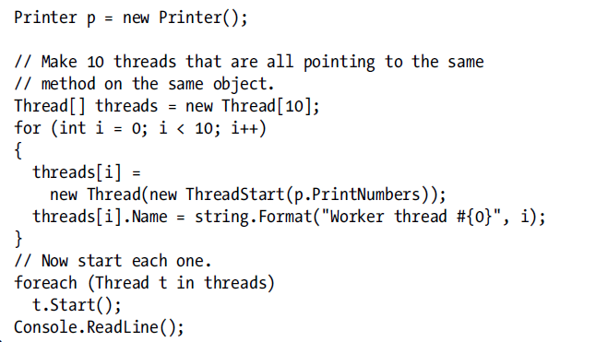
Concurrency problem

Slide 31
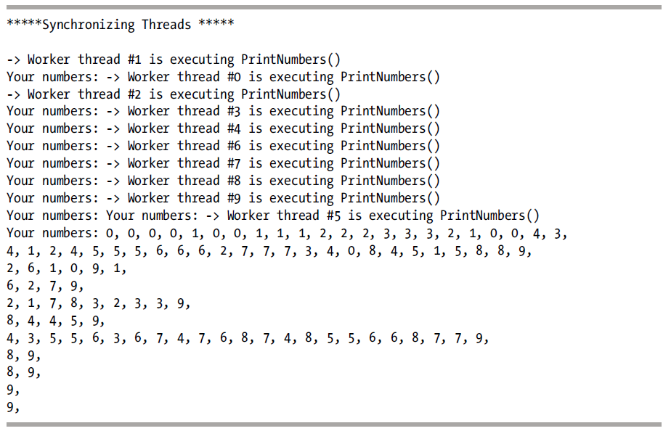
Result

Slide 32
The lock statement
lock (threadLock)
{
// Display Thread info.
Console.WriteLine("-> {0} is executing PrintNumbers()",
Thread.CurrentThread.Name);
// Print out numbers.
Console.Write("Your numbers: ");
for (int i = 0; i < 10; i++)
{
Random r = new Random();
Thread.Sleep(100 * r.Next(5));
Console.Write("{0}, ", i);
}
Console.WriteLine();
}

Slide 33
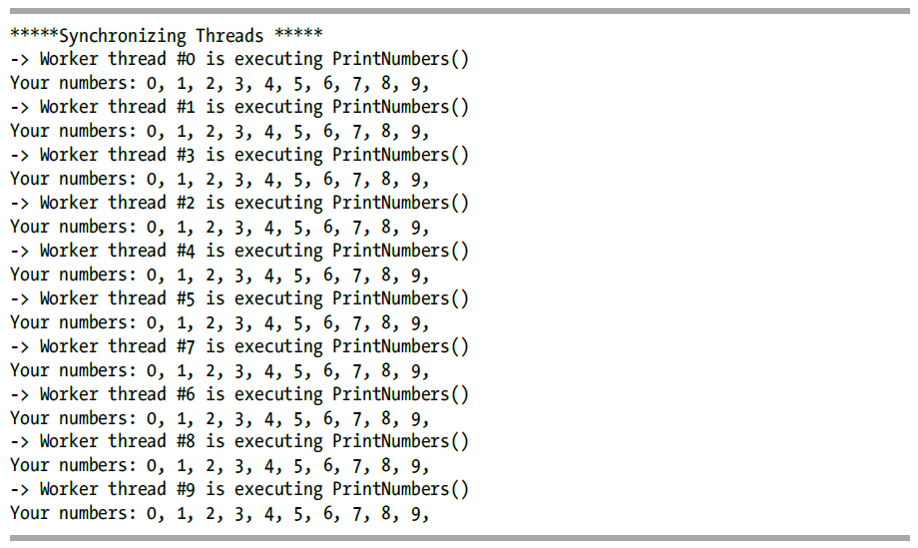
Result

Slide 34
Topic for next class
Await/async

